Slide 1
Light IT up.
Microsoft Learning
Ignite | May 4 – 8, 2015 | Chicago, IL

Slide 2
Exam Prep: 70-480 HTML5, CSS3 and JavaScript
Sidney Andrews
Director of Developer Training
Opsgility
@sidney_andrews

Slide 3
Session Objectives
Understand the objective domain for the 70-480 exam
Review a selection of topics covered by the exam

Slide 4
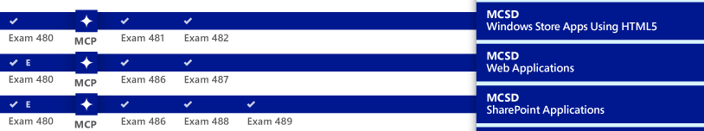
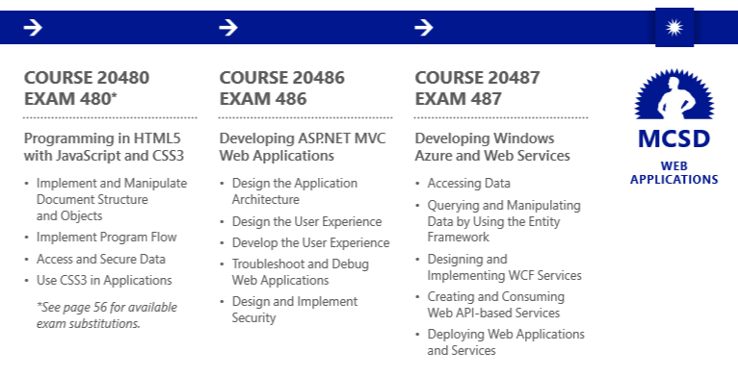
Roadmap – Developer Certification
http://bit.ly/Ignite-CertApp
Notes:
For Exam 480 Session
REMINDER: The following certifications use Exam 480 as the first exam in path:
MCSD: Web Applications
MCSD: SharePoint Applications
MCSD: Windows Store Apps using HTML5

Slide 5
Agenda
Exam Tips
Exam Topics
With example questions and answers!

Slide 6
Exam Topics

Slide 7
Exam Outline

Slide 8
Topics Outline
Drawing, Style and Animations
HTML5 Objects
Remote Communication
JavaScript

Slide 9
Drawing, Style and Animations

Slide 10
SVG Shapes
Circle
Ellipse
Rectangle
Polyline
Polygon
Path

Slide 11
Path Commands
Command | Name
M | Move to location
L | Draw line
A | Elliptical Arc
Q | Quadratic Bezier curve
C | Cubic Bezier curve
Z | Close path

Slide 12
Demo
SVG

Slide 13
Transformations
Translate
Rotate
Scale
Skew

Slide 14
Transitions
transition-property
transition-duration
transition-timing-function
linear (default)
ease
ease-in
ease-out
ease-in-out
cubic-bezier

Slide 15
Canvas
var canvas = document.getElementById('canvas');
var context = canvas.getContext('2d');
context.clearRect(0, 0, canvas.width, canvas.height);
context.strokeStyle = "rgb(0, 0, 255)";
context.fillStyle = "rgba(255, 0, 0, 0.75)";
// Create a path
context.beginPath();
context.moveTo(20, 20);
context.lineTo(80, 70);
context.lineTo(40, 110);
context.closePath();

Slide 16
Canvas
// Draw the outline and fill the shape
context.stroke();
context.fill();

Slide 17
CSS Selectors

Slide 18
Selectors
CSS3 Selectors Include:
> Direct descendent
+ Adjacent (after
:after Add content after item
:required Filter to required input items
And many more…

Slide 19
Demo
CSS Selectors

Slide 20
Question
<nav>
<ul>
<li><a href="~/Details">Details</a>
</ul>
<div><a href="~/About">About</a></div>
</nav>
You need to ensure all <a> elements in the <nav> section do not have an underline.
What CSS selector should you use?
a.
nav
b.
nav > a
c.
nav a
d.
nav > div > a

Slide 21
Question
You have a custom font that is required for your site. The ttf file has been added to the server.
You need to ensure all clients are able to use this font.
What should you add to your CSS file?
(Choose all that apply. Each answer represents part of the solution.)
a.
@font-face { font-family: Custom; src: url('custom.ttf'); }
b.
body { font-family: Custom, sans-serif; }
c.
body { font-family: sans-serif, Custom; }
d.
@font-face { font-family: sans-serif; src: url('custom.ttf'); }

Slide 22
Question
You have a web application.
You need to ensure all textboxes that are required have a yellow background.
What should you add to the stylesheet?
a.
input:valid { background-color: yellow; }
b.
input:required { background-color: yellow; }
c.
input#required { background-color: yellow; }
d.
input:invalid { background-color: yellow; }

Slide 23
HTML5 Objects

Slide 24
Audio/Video
<video width="500" height="300" poster="logo.jpg"
controls autobuffer autoplay loop mute>
<source src="Video.mp4" type="video/mp4" />
<source src="Video.ogg" type="video/ogg" />
</video>

Slide 25
Demo
Video

Slide 26
Application Cache
CACHE MANIFEST
#VERSION 1.0
CACHE:
/index.html/styles/site.css
/images/logo.jpg
NETWORK:
/members
FALLBACK:
/details/ /offline.html

Slide 27
Updating Application Cache
// download new application cache
applicationCache.Update();
// wait for the data to be downloaded, then swap cache
if (applicationCache.status == 4) {
applicationCache.swapCache();
}

Slide 28
Geolocation
Methods
getCurrentPosition
watchPosition
Return Data
latitude
longitude
accuracy
Altitude
altitudeAccuracy
heading
speed
Options
enableHighAccuracy
maximumAge
timeout

Slide 29
Question
You have an e-commerce application.
You need to store information about the product the user is currently viewing in the browser. You need to ensure this information is not shared across tabs in the browser.
What object should you use?
a.
localStorage
b.
sessionStorage
c.
Cookies
d.
ASP.NET Session object

Slide 30
Question
You have a page that display a news article. A snippet of the page is displayed below:
<body>
<header>
<h2>Article Title</h2>
</header>
<article>content</article>
</body>
You need to display the article using 3 columns if the browser window is wider than 1024 pixels. Otherwise, one column should be used. What should you do? (Choose all that apply. Each answer represents part of the solution.)
a.
@media (max-width: 1024) { article {column-count: 1;} }
b.
@media (max-device-width: 1024) { article {column-count: 3;} }
c.
article { column-count: 1; }
d.
article { column-count: 3; }

Slide 31
JavaScript

Slide 32
Web Worker
var worker = new Worker("/Scripts/Worker.js");
worker.onmessage = function (event) {
$("#messageList").append("<li>" + event.data + "</li>");
};
// postMessage sends signals to the web worker
// Web worker starts automatically, so if you want to delay execution
// you need to provide that mechanism
worker.postMessage("START");
$("#send").click(function () {
worker.postMessage($("#message").val());
});

Slide 33
Worker.js
var started = false;
self.onmessage = function (event) {
if (event.data == "START") {
startWork();
} else {
sendMessage(event.data);
}
}
// postMessage sends signals to the caller
function startWork() {
started = true;
self.postMessage("Worker started.");
}
function sendMessage(message) {
if (started) self.postMessage(message);
}

Slide 34
Demo
Web Workers

Slide 35
Creating Objects
"use strict";
var Student = function (name) {
var name = name;
var getName = function () {
return name;
};
return {
get_name: getName
}
};
var student = new Student("Christopher");
alert(student.get_name());

Slide 36
Remote Communication

Slide 37
XML HTTP Request
var request = new XMLHttpRequest();
request.open("GET", "/products/list", true);
request.onreadystatechange = function () {
if (request.readyState === 4) {
var response = JSON.parse(request.responseText);
var productList = response.productList;
displayList();
}
};
request.send();

Slide 38
Reading JSON
function displayLocations(result) {
for (var i = 0; i < result.d.length; i++) {
var product = result.d[i];
var item = "<li>" + product.Name + "</li>"
$("#products-list").append(item);
}
}

Slide 39

jQuery
JavaScript Library that focuses on document traversal and DOM manipulation
Also handles:
CSS3 selectors for traversal
Event handling and routing
Animation
Ajax Calls
CSS3 Compliant
Lightweight
Cross-Browser

Slide 40
Demo
jQuery

Slide 41
AJAX
var productJSON = JSON.stringify({ newProduct: product });
$.ajax({
url: "/Services/ProductService.svc/Add",
type: "POST",
dataType: "json",
contentType: "application/json; charset=utf-8",
data: productJSON,
success: displayLocations,
failure: displayError
});

Slide 42
Web Sockets
if (window.WebSocket) {
var socket = new WebSocket('wss://url.com/endpoint');
socket.onopen = function () {
socket.send('hello, world');
}
socket.onmessage = function (event) {
if (event.type == 'Text') {
$('#output').text(event.data);
}
}
}

Slide 43
Question
You have the following content on your web page:
1 <script src="Scripts/jquery-2.1.0.min.js"></script>
2 <script>
3 "use strict";
4 function updatePage() { $(“output").text("Hello, world!"); }
5 updatePage();
6 </script>
7 <div id="output"></div>
When you view the web page no text is displayed.
What should you do?
a.
Update line 4 to function updatePage() { $(“.output").text("Hello, world!"); }
b.
Update line 5 to $(updatePage);
c.
Update line 4 to function updatePage() { $(“#output").text("Hello, world!"); }
d.
Update line 5 to $("#output").load(updatePage);

Slide 44
Question
You have a web page with multiple buttons that use a class named submit. You have added a reference to jQuery.
When a button is clicked, you need to disable it.
What script block should you use?
a.
$('.submit').click(function () { this.disabled = true; });
b.
$('#submit').click(function () { this.prop('disabled', true); });
c.
$('#submit').click(function () { $(this).disabled = true; });
d.
$('.submit').click(function () { $(this).prop('disabled', true); });

Slide 45
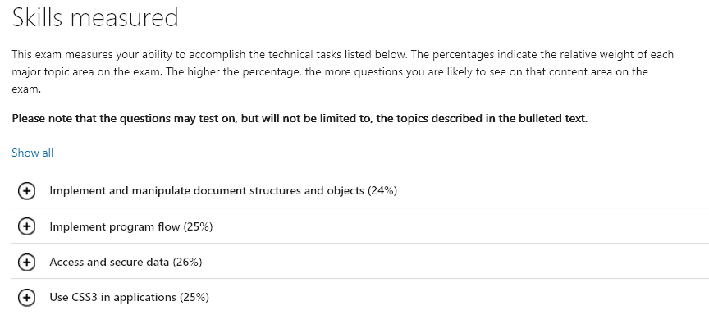
Microsoft Learning Website
http://www.microsoft.com/learning/en-us/exam-70-480.aspx

Slide 46
Microsoft Virtual Academy
Developing Universal Windows Apps with HTML and JavaScript Jump Start
http://www.microsoftvirtualacademy.com/training-courses/developing-universal-windows-apps-with-html-and-javascript-jump-start
HTML5 & CSS3 Fundamentals: Development for Absolute Beginners
http://www.microsoftvirtualacademy.com/training-courses/html5-css3-fundamentals-development-for-absolute-beginners

Slide 47
Microsoft Virtual Academy
HTML5 App Development Fundamentals
http://www.microsoftvirtualacademy.com/training-courses/html5-app-development-fundamentals
JavaScript Fundamentals for Absolute Beginners
http://www.microsoftvirtualacademy.com/training-courses/javascript-fundamentals-for-absolute-beginners

Slide 48
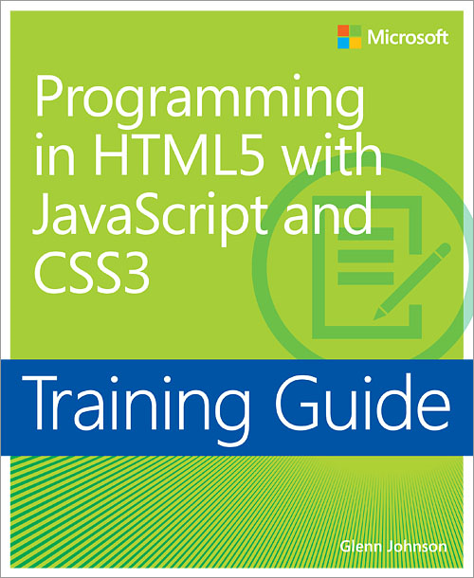

Microsoft Press
Training Guide: Programming in HTML5 with JavaScript and CSS3 | Exam Ref 70-480: Programming in HTML5 with JavaScript and CSS3

Slide 49
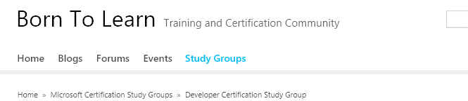
BornToLearn
http://borntolearn.mslearn.net/

Slide 50
BornToLearn
Discussion Forum
Exam Prep Wiki

Slide 51
Review
Session Objectives
Understand where 70-480 fits into overall certification goals
Understand the objective domain for the 70-480 exam
Review a selection of topics covered by the exam
Exam Tips
Exam Topics
Drawing, Style and Animations
HTML5 Objects
Remote Communication
JavaScript

Slide 52
Resources
Microsoft Learning Site microsoft.com/learning
Your one-stop location for info on all available Microsoft certifications, training, and exam prep resources
Microsoft Virtual Academy microsoftvirtualacademy.com
Your source for on-demand, online technical training
Microsoft Training and Certification Guide -Link to the app: http://aka.ms/ignite-certapp
Interactive Windows 8.1 app, to help you choose and traverse your path

Slide 53
Demos
GitHub: http://bit.ly/1H2hoZM
All demo code can be found here. This is a simple Node.js app using Angular and Bootstrap
https://github.com/SidneyAndrewsOpsgility/HTML5Demos

Slide 54
© 2015 Microsoft Corporation. All rights reserved.

